Slide 1



Design and Development of LLC Resonant Converter for EV charging
(MTP - Stage 0 )
Aditya Kumar
Guide: Prof. Siddavatam Ravi Prakash Reddy
Electrical Machines & Power Electronic Systems (EMPES) Lab
Department of Energy Science and Engineering
Indian Institute of Technology Bombay

Slide 2

Converter Specifications
Parameter | Value
Input voltage (Vin) | 20 V
Resonant tank inductor (Lr) | 84.142 µH
Resonant tank capacitor (Cr) | 481.667 nF
Resonant frequency (fr) | 25 kHz
Output inductor (L) | 80 µH
Output capacitor (C) | 500 µF
Switches and Diodes | Ideal

Slide 3
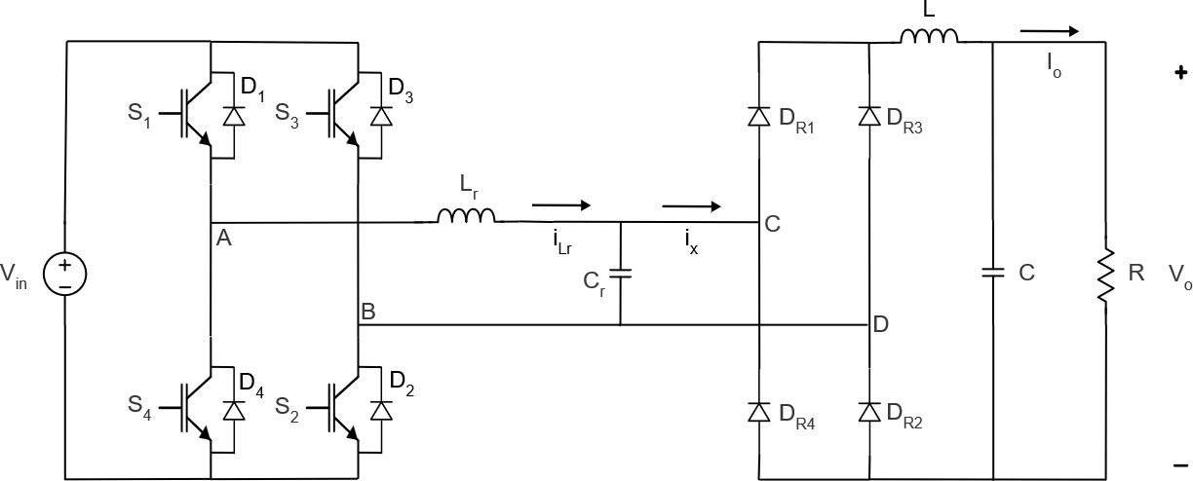
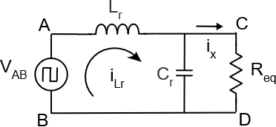

DC-DC Parallel Resonant Converter
Equivalent resistance
Req = $\frac{π^{2}R}{8}$
Resonant frequency
fr = $\frac{1}{2π\sqrt{L_{r}C_{r}}}$
Voltage gain (FHA)
$\frac{v_{CD,1}}{v_{AB,1}}$ = $\frac{1}{\sqrt{{\left(1 − ω_{s}^{2} L_{r} C_{r}\right)}^{2}+ {\left(\frac{ωL_{r}}{R_{eq}}\right)}^{2} }}$
G = $\frac{V_{o}}{V_{in}}$ = $\frac{8/{π^{2}}}{\sqrt{{(1−ω_{n}^{2})}^{2}+{\left(\frac{ω_{n}}{Q_{e}}\right)}^{2}}}$
where- $ω_{n}= \frac{ω_{s}}{ω_{r}}$
Equivalent circuit

Slide 4
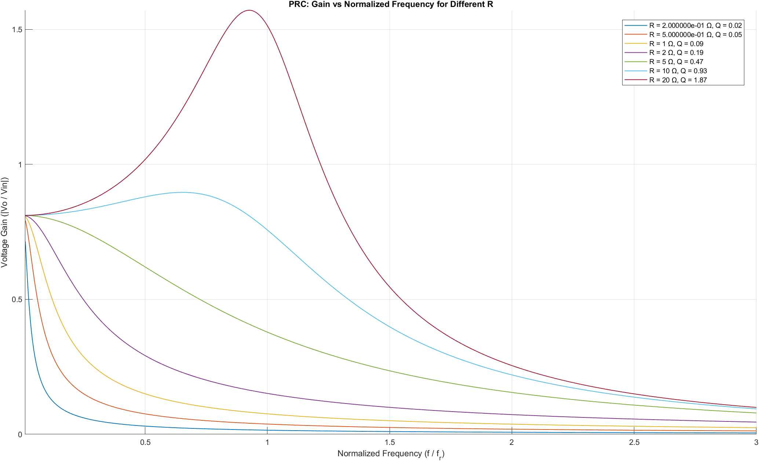
Gain vs. switching frequency curve
Light load
Heavy load

Slide 5
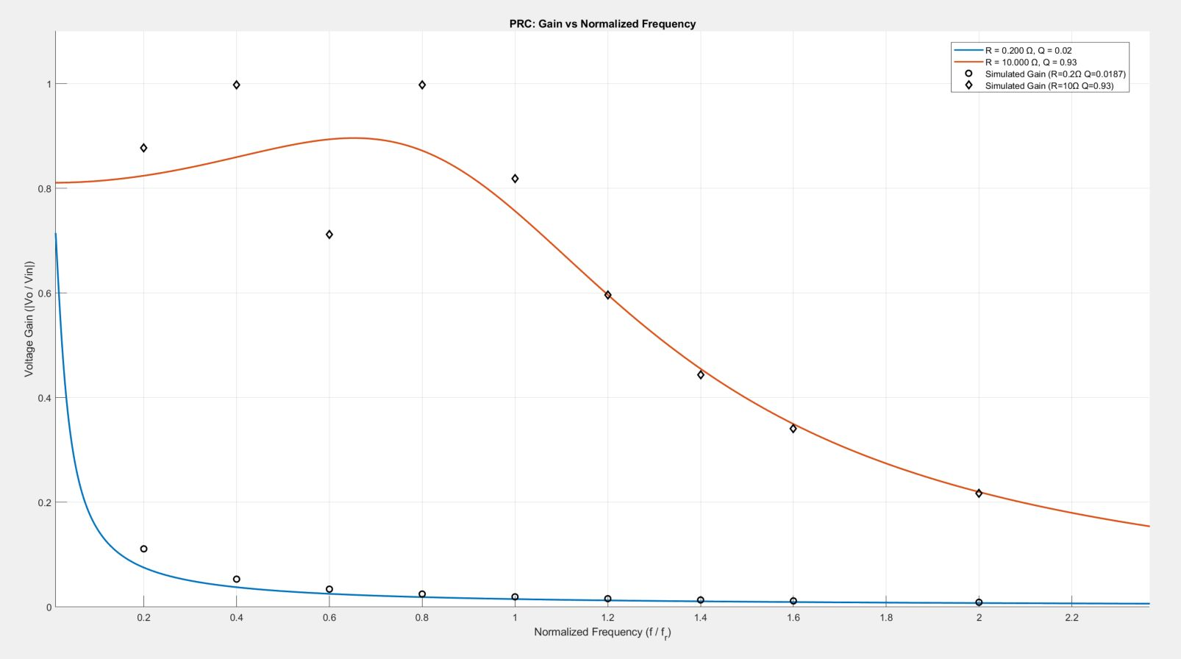
Analytical vs. Simulated gain
Gain is reduced suddenly

Slide 6
Analytical vs. Simulated gain
Gain is reduced suddenly

Slide 7
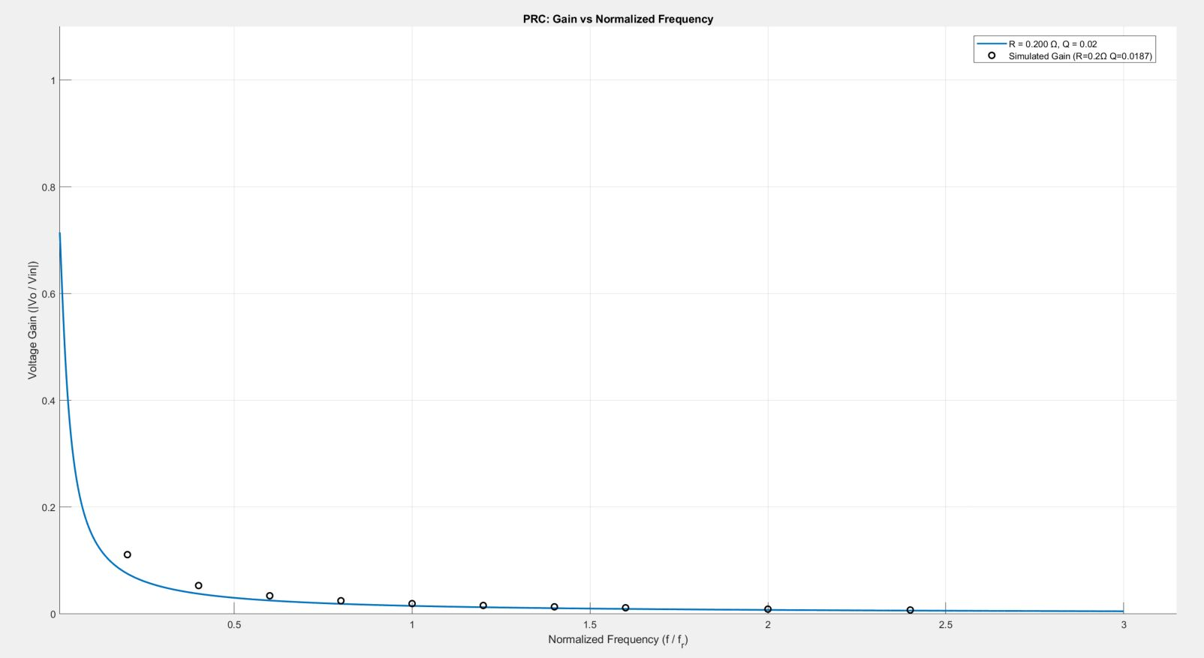
Analytical vs. Simulated Gain (R = 0.2 Ω)
 | Heavy Load
Analytical vs. Simulated (R = 0.2 ohm Q = 0.0187)
fs (kHz) | Gain (calc) | Gain (simu) | Error %
5 | 0.0754 | 0.1111 | 32.1708
10 | 0.0378 | 0.0532 | 28.9454
15 | 0.0252 | 0.0341 | 26.0556
20 | 0.0189 | 0.0248 | 23.7324
25 | 0.0151 | 0.0194 | 21.9998
30 | 0.0126 | 0.0159 | 20.6935
35 | 0.0108 | 0.0134 | 19.3454
40 | 0.0095 | 0.0116 | 18.4832
50 | 0.0076 | 0.009 | 15.9661
60 | 0.0063 | 0.0074 | 14.8555
80 | 0.0047 | 0.0054 | 12.5573
100 | 0.0038 | 0.0042 | 10.1483
120 | 0.0031 | 0.0034 | 7.6180
140 | 0.0027 | 0.0028 | 3.9852
160 | 0.0023 | 0.0024 | 2.1467
180 | 0.0021 | 0.0021 | 0.7788
200 | 0.0019 | 0.0019 | 1.5058
220 | 0.0017 | 0.0017 | 0.1543
240 | 0.0016 | 0.0015 | 3.4703
260 | 0.0014 | 0.0014 | 2.0578
280 | 0.0013 | 0.0013 | 1.7628
300 | 0.0012 | 0.0012 | 2.5759

Slide 8
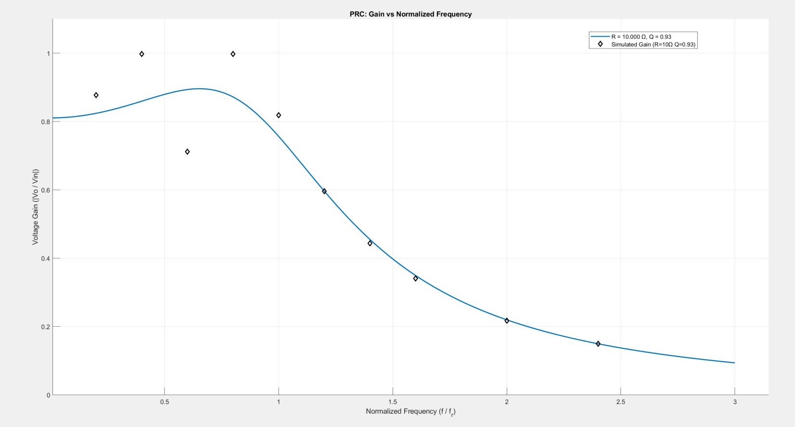
Analytical vs. Simulated Gain (R = 10 Ω)
 | Light Load
Analytical vs. Simulated (R = 10 ohm Q = 0.93)
fs (kHz) | Gain (calc) | Gain (simu) | Error %
5 | 0.8241 | 0.8768 | 6.01425193
10 | 0.8596 | 0.9978 | 13.85354871
15 | 0.8936 | 0.7116 | 25.57701399
20 | 0.8720 | 0.9976 | 12.59479065
25 | 0.7566 | 0.8186 | 7.573703361
30 | 0.5965 | 0.5959 | 0.105811963
35 | 0.4552 | 0.444 | 2.51717672
40 | 0.3497 | 0.3411 | 2.529153426
50 | 0.2199 | 0.2171 | 1.275628923
60 | 0.1498 | 0.1494 | 0.285589353
80 | 0.0822 | 0.0828 | 0.669632248
100 | 0.0520 | 0.0525 | 1.030170145
120 | 0.0358 | 0.0363 | 1.335385406
140 | 0.0262 | 0.0265 | 1.161891325
160 | 0.0200 | 0.0203 | 1.515482788
180 | 0.0158 | 0.016 | 1.480382517
200 | 0.0127 | 0.0129 | 1.172480896
220 | 0.0105 | 0.0107 | 1.642487359
240 | 0.0088 | 0.009 | 1.825910102
260 | 0.0075 | 0.0076 | 1.005956291
280 | 0.0065 | 0.0066 | 1.762630597
300 | 0.0056 | 0.0057 | 0.955275492

Slide 9
Key Observations and Inferences
For fs = fr
Gain > 1 (not maximum)
Depends on Q
            For fs ≠ fr
            No direct comments on gain w.r.t. ‘1’ (depends on combination of Q and fs )
For R = 0.2 Ω, Q = 0.0187
For fs << fr : Simulated gain > Analytical gain
For fs = fr : Simulated gain = Analytical gain
For fs > fr : Simulated gain = Analytical gain
For R = 10 Ω, Q = 0.93
For fs < fr : Simulated gain > Analytical gain
For fs = fr : Simulated gain > Analytical gain
For fs > fr : Simulated gain = Analytical gain
Can act as both Buck or Boost converter
Peak does not occurs at fr
(depends on load)
Peak shifts left for high loading conditions
Voltage variation at light load is not an issue
Large circulating currents in resonant tank at light load

Slide 10
Inductor Design (Ap method)

Slide 11
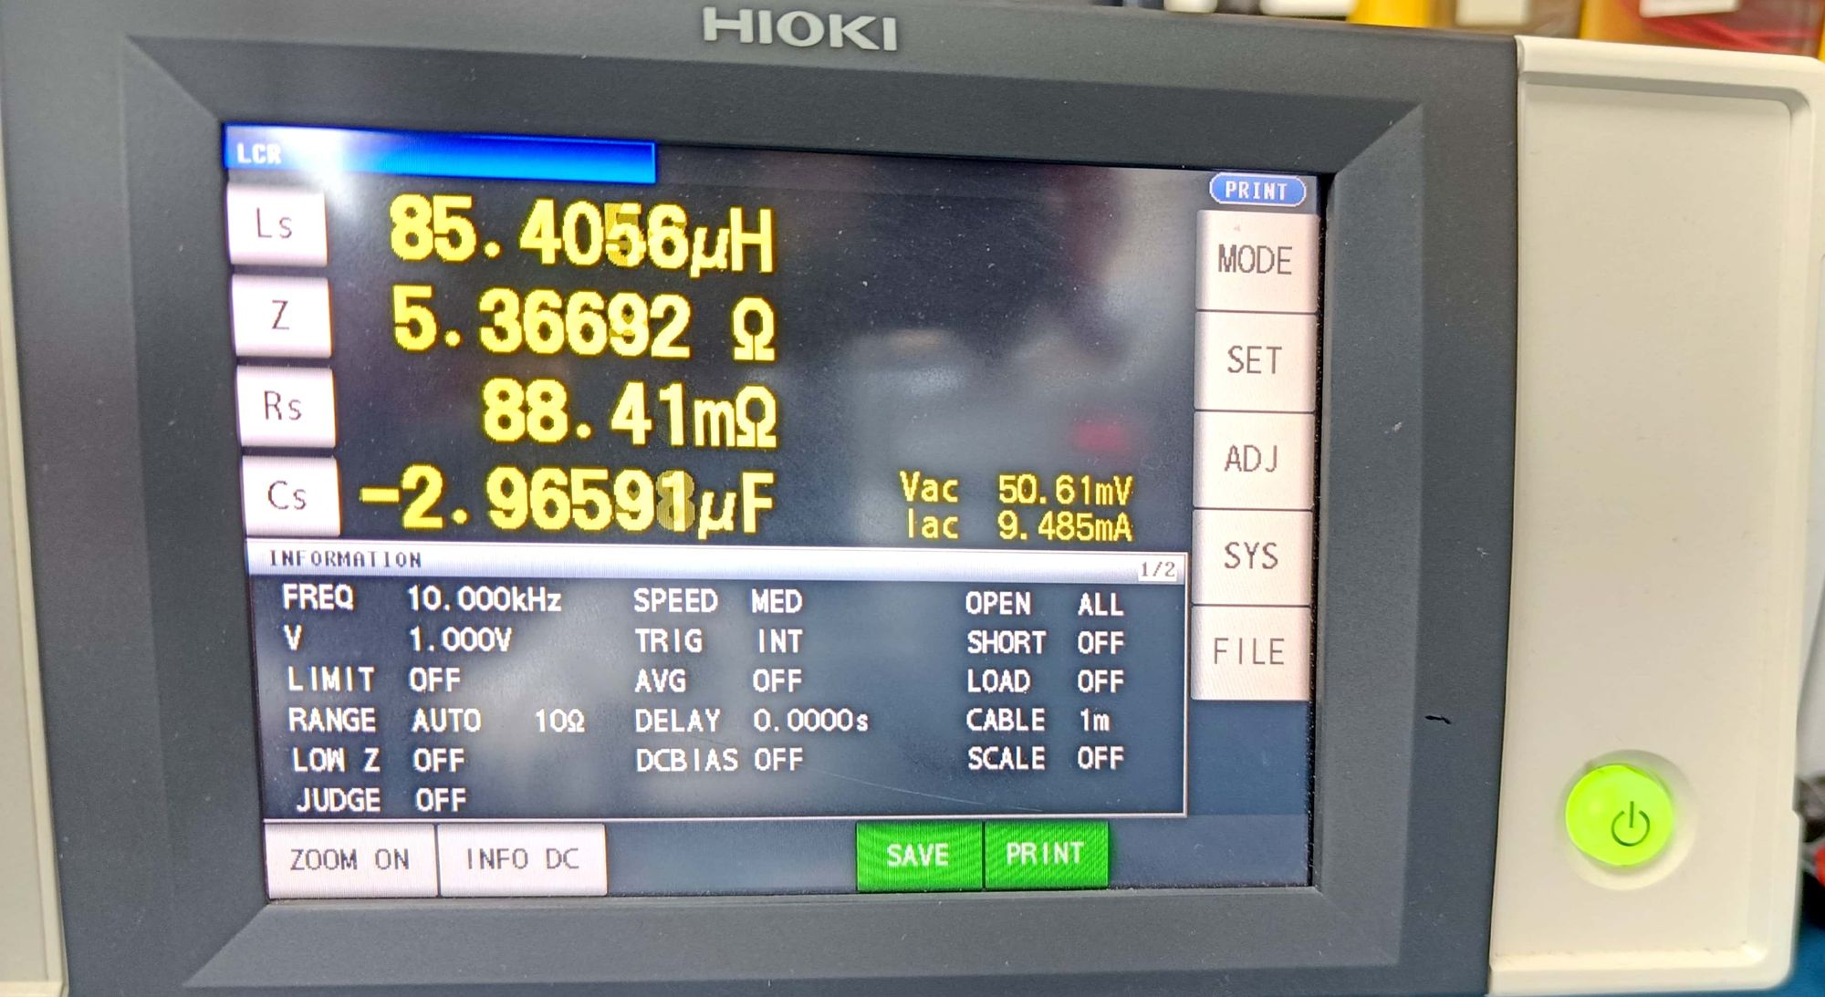
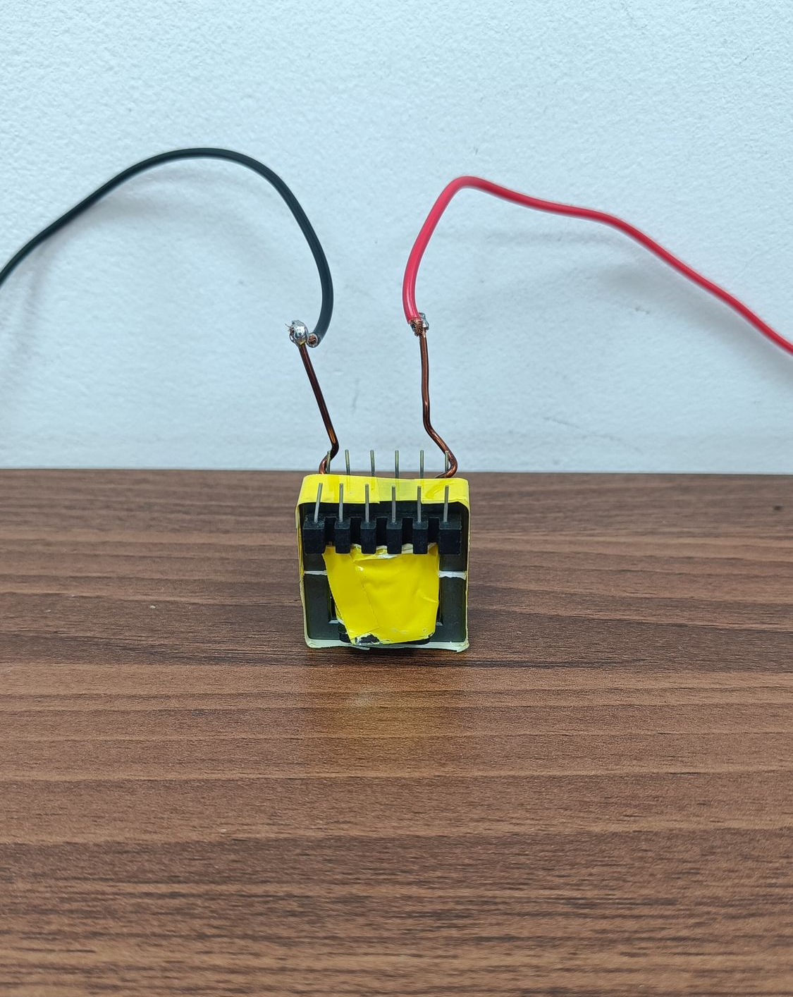
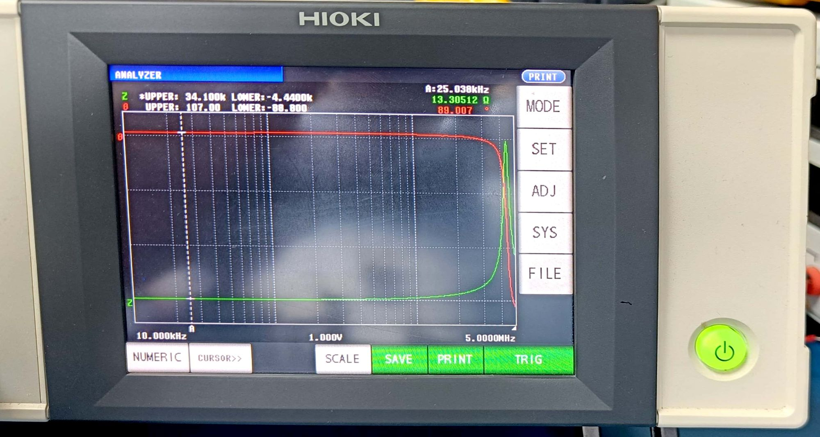
Inductor Design (cont.)
Impedance analyser display in LCR mode
Bode Plot of Inductor Impedance from Analyzer Mode

Slide 12
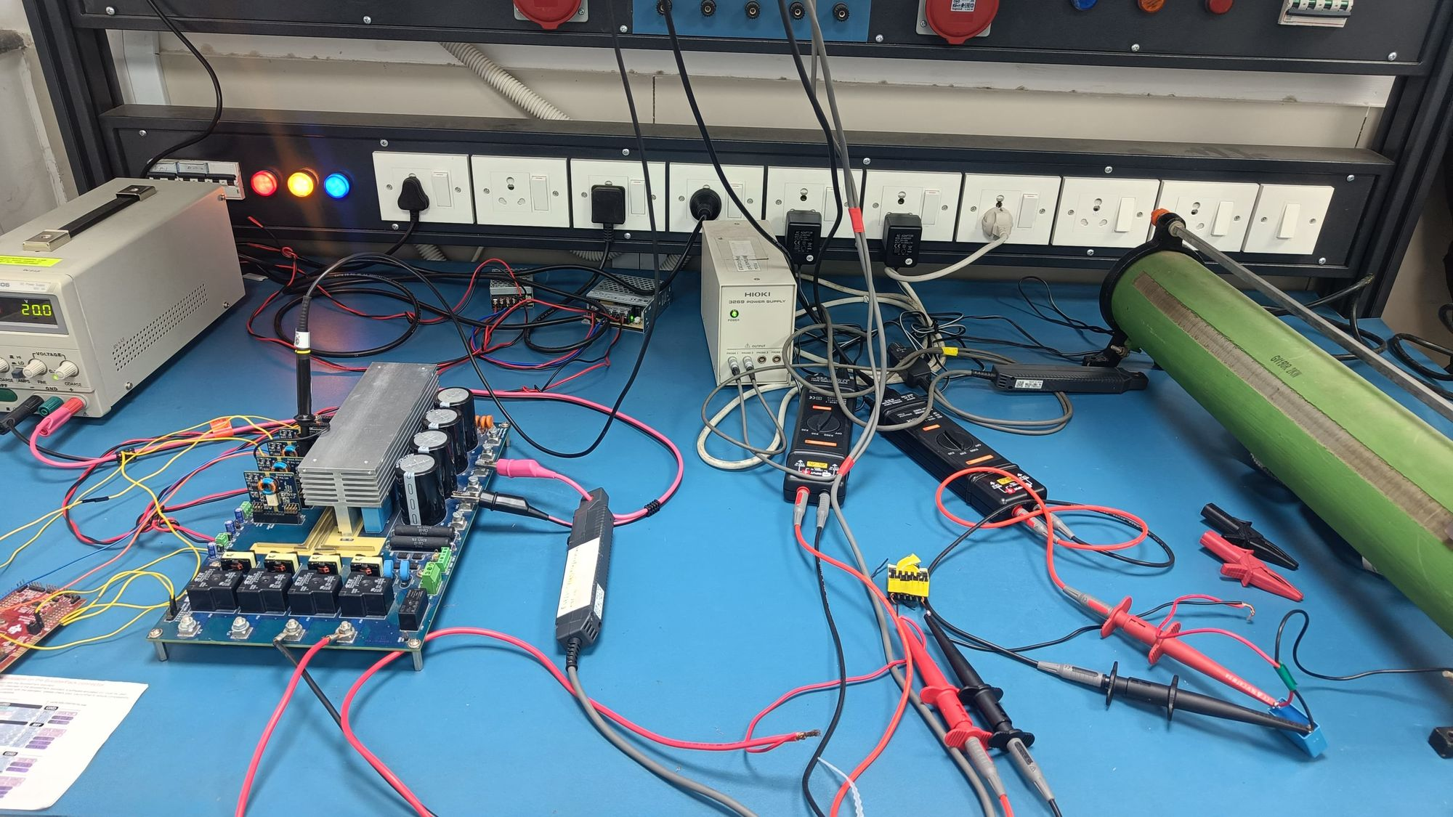
Experimental Setup
Specifications
Nova board – used as inverter
IGBTs - IKW25N120H3
Inductor – 84.142 µH, 5A (designed)
Capacitor – 481.67 nF, Bipolar
Load - 10Ω
Microcontroller – TMS320F28379D

Slide 13
Experimental Setup
Specifications
Nova board – used as inverter
IGBTs - IKW25N120H3
Inductor – 84.142 µH, 5A (designed)
Capacitor – 481.67 nF, 1 kV, Bipolar
Load - 10Ω
Microcontroller – TMS320F28379D

Slide 14
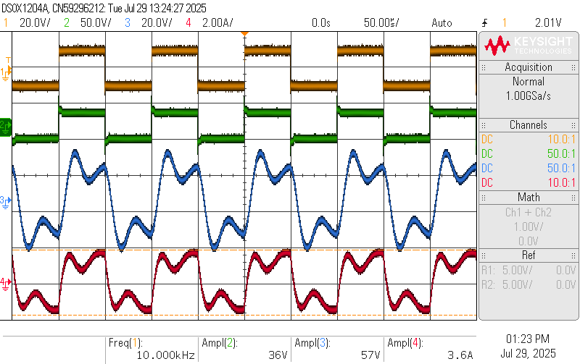
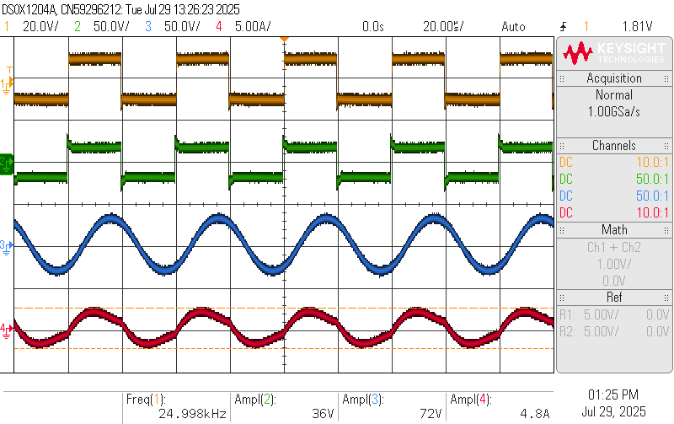
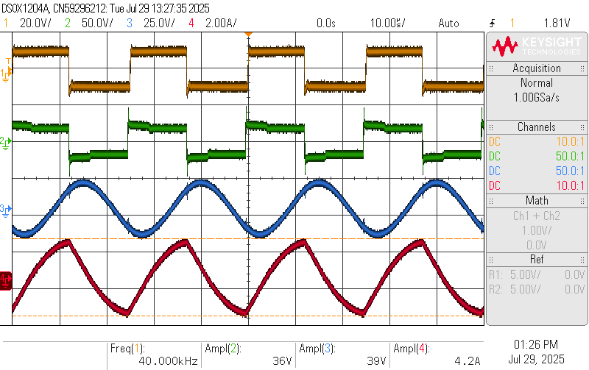
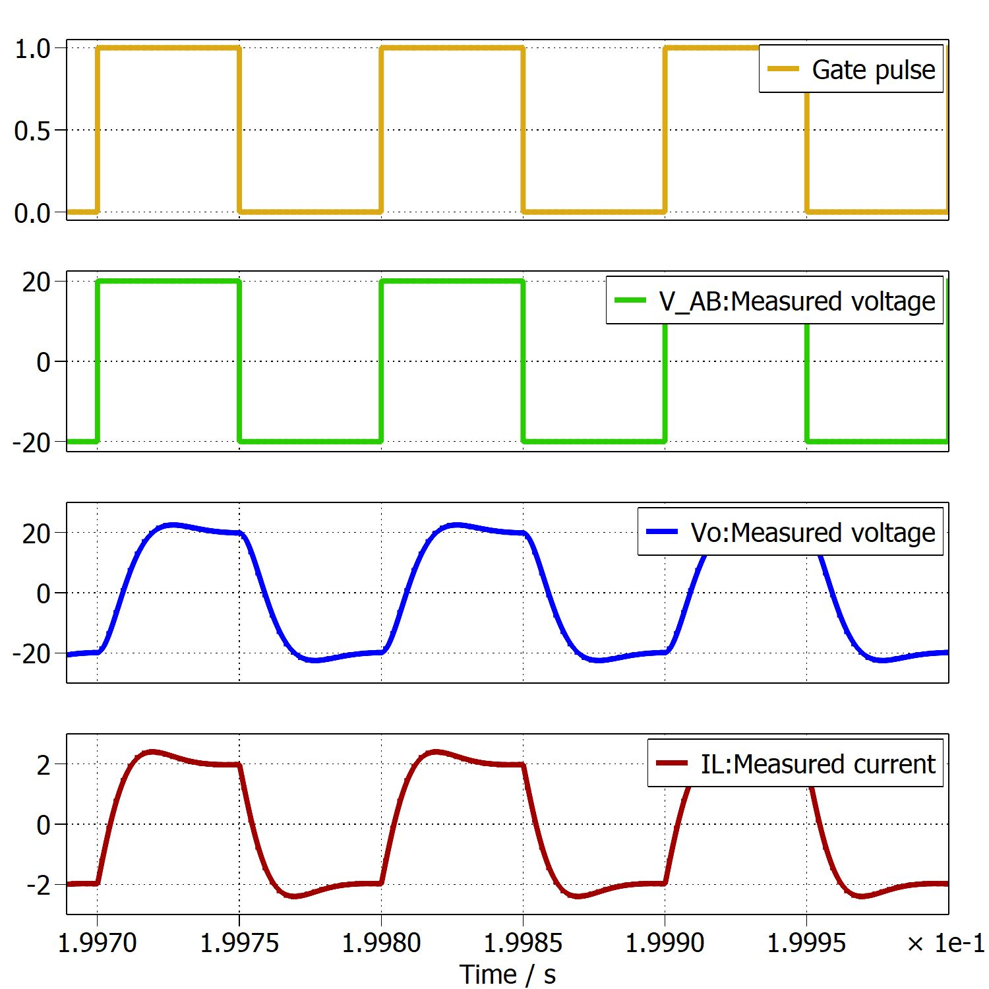
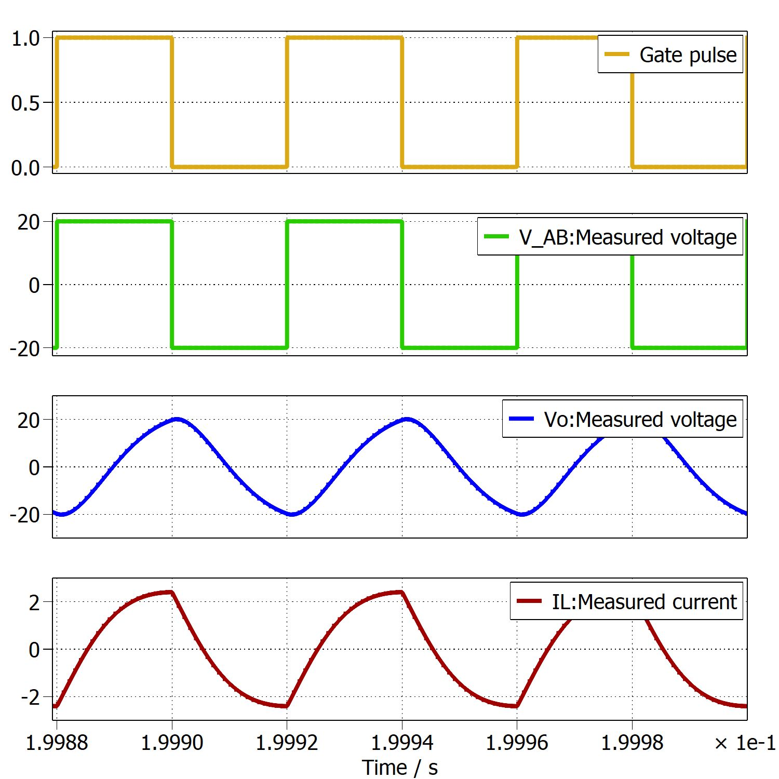
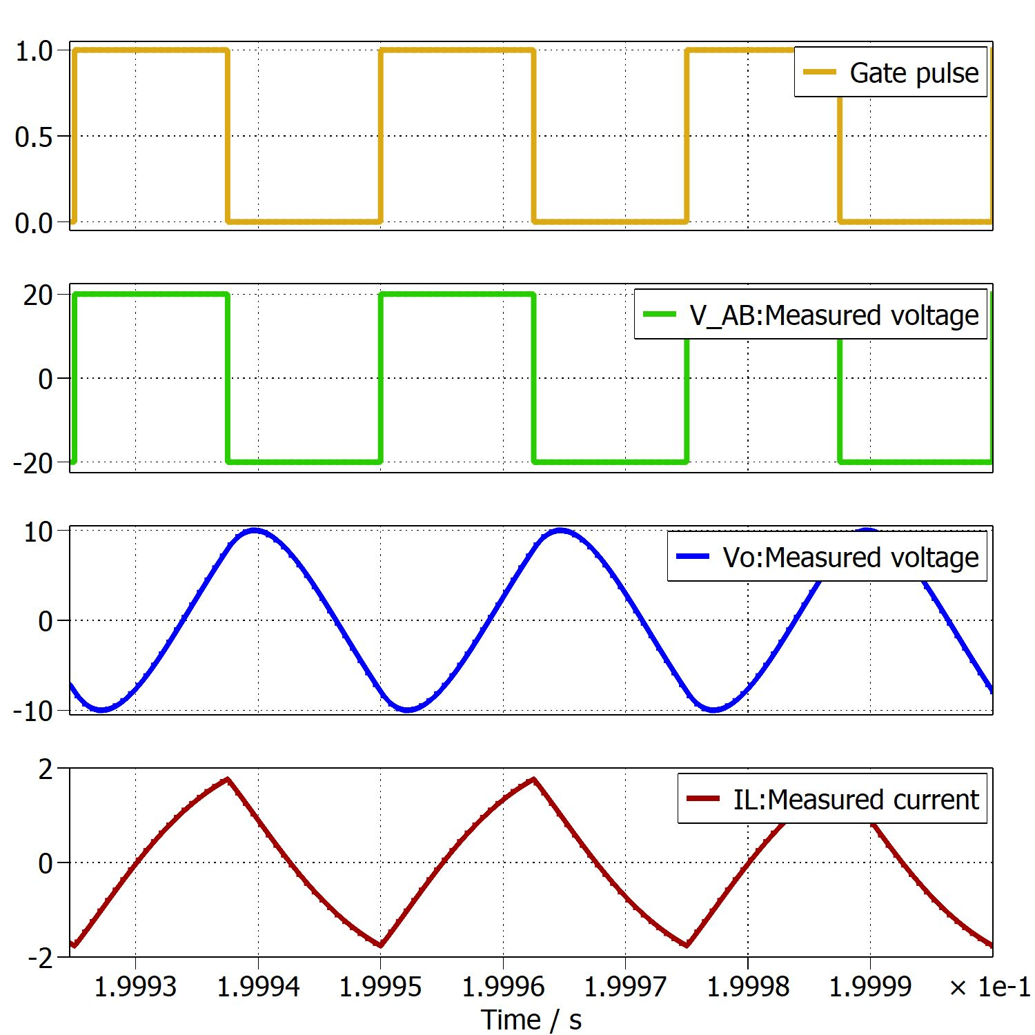
Parallel Resonant Inverter (PRI)
Gate, VAB, Vo, ILr
Inferences
More ripples are found in Vo at 10kHz
10 kHz – No discontinuous conduction
Highest output voltage occurs at fr
At higher fs, Vo continue to rise even after VAB become negative
Irregularity – Zero crossing of inductor voltage waveform at resonant frequency
fsw = 10 kHz
fsw = 25 kHz
fsw = 40 kHz

Slide 15
Parallel Resonant Inverter (PRI)
Gate, VAB, Vo, ILr
Inferences
More ripples are found in Vo at 10kHz
10 kHz – No discontinuous conduction
Highest output voltage occurs at fr
At higher fs, Vo continue to rise even after VAB become negative
Irregularity – Zero crossing of inductor voltage waveform at resonant frequency
fsw = 10 kHz
fsw = 25 kHz
fsw = 40 kHz

Slide 16
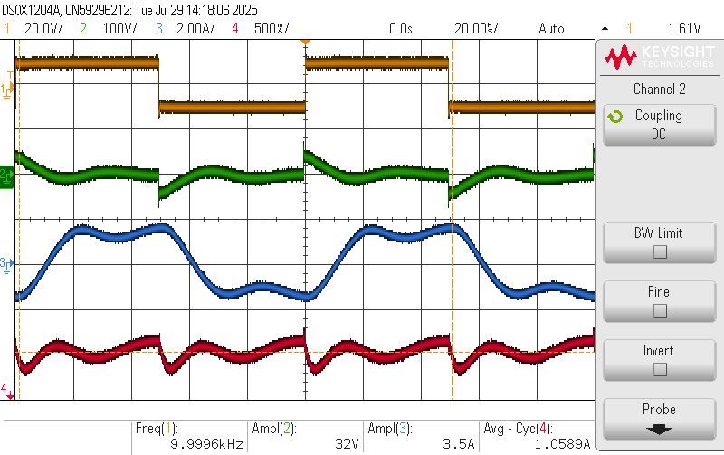
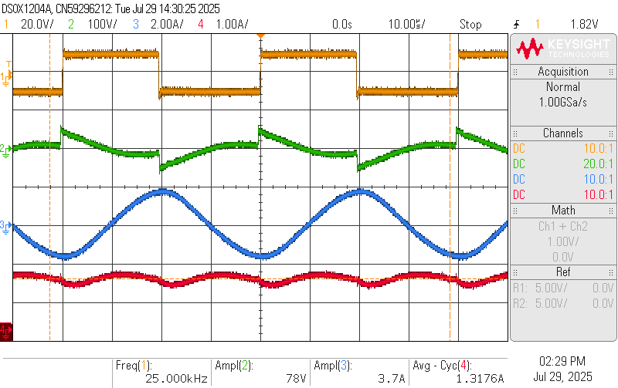
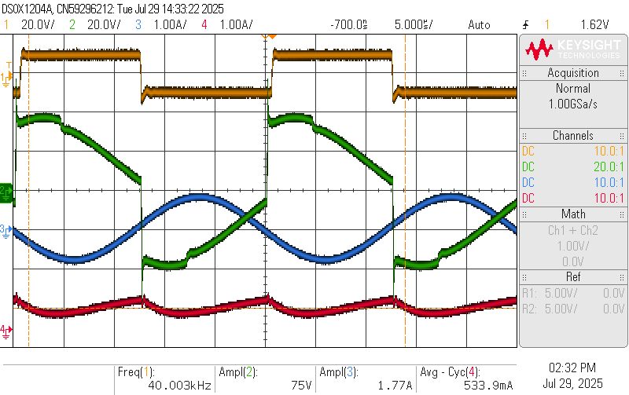
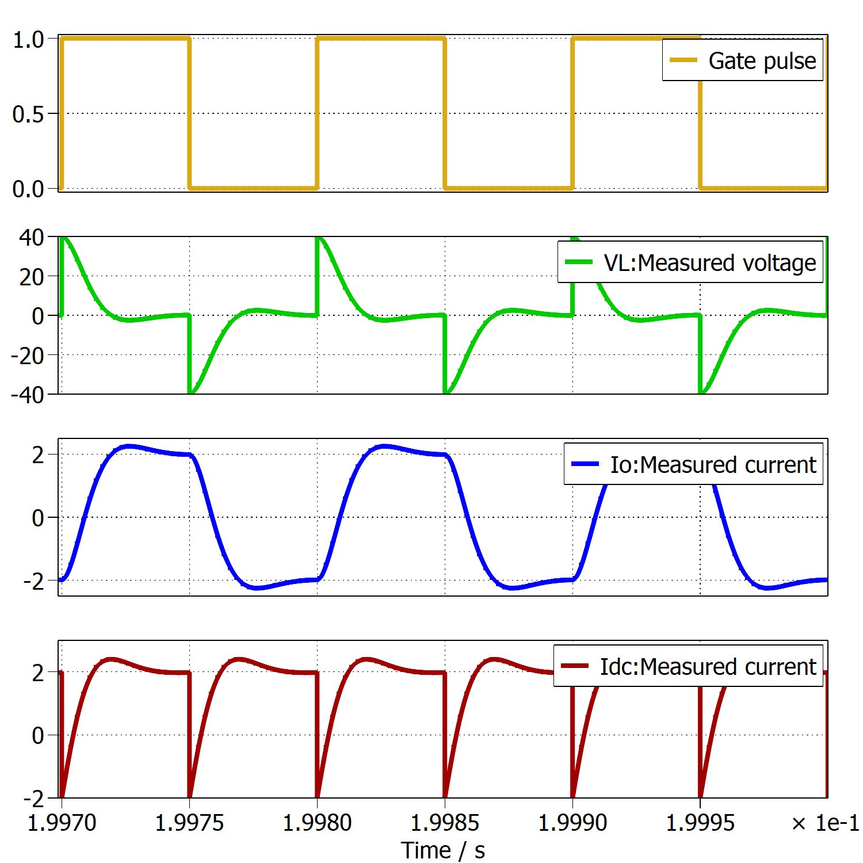
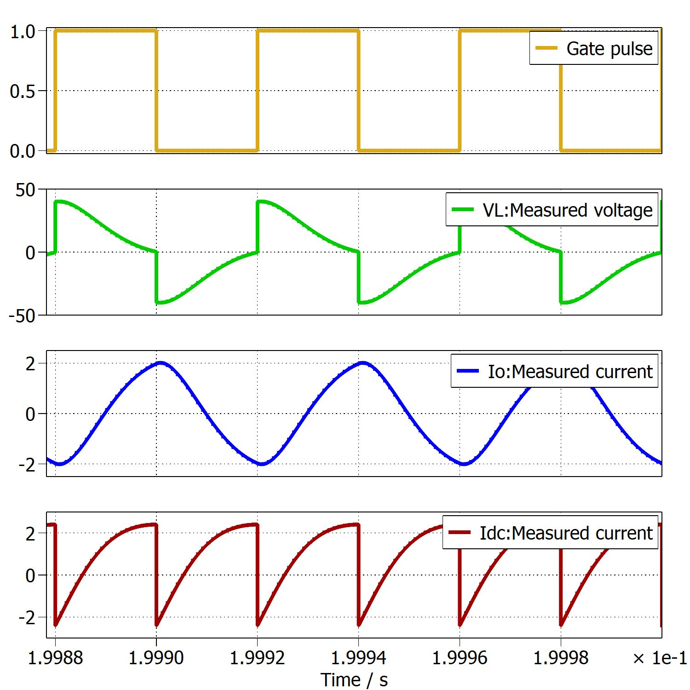
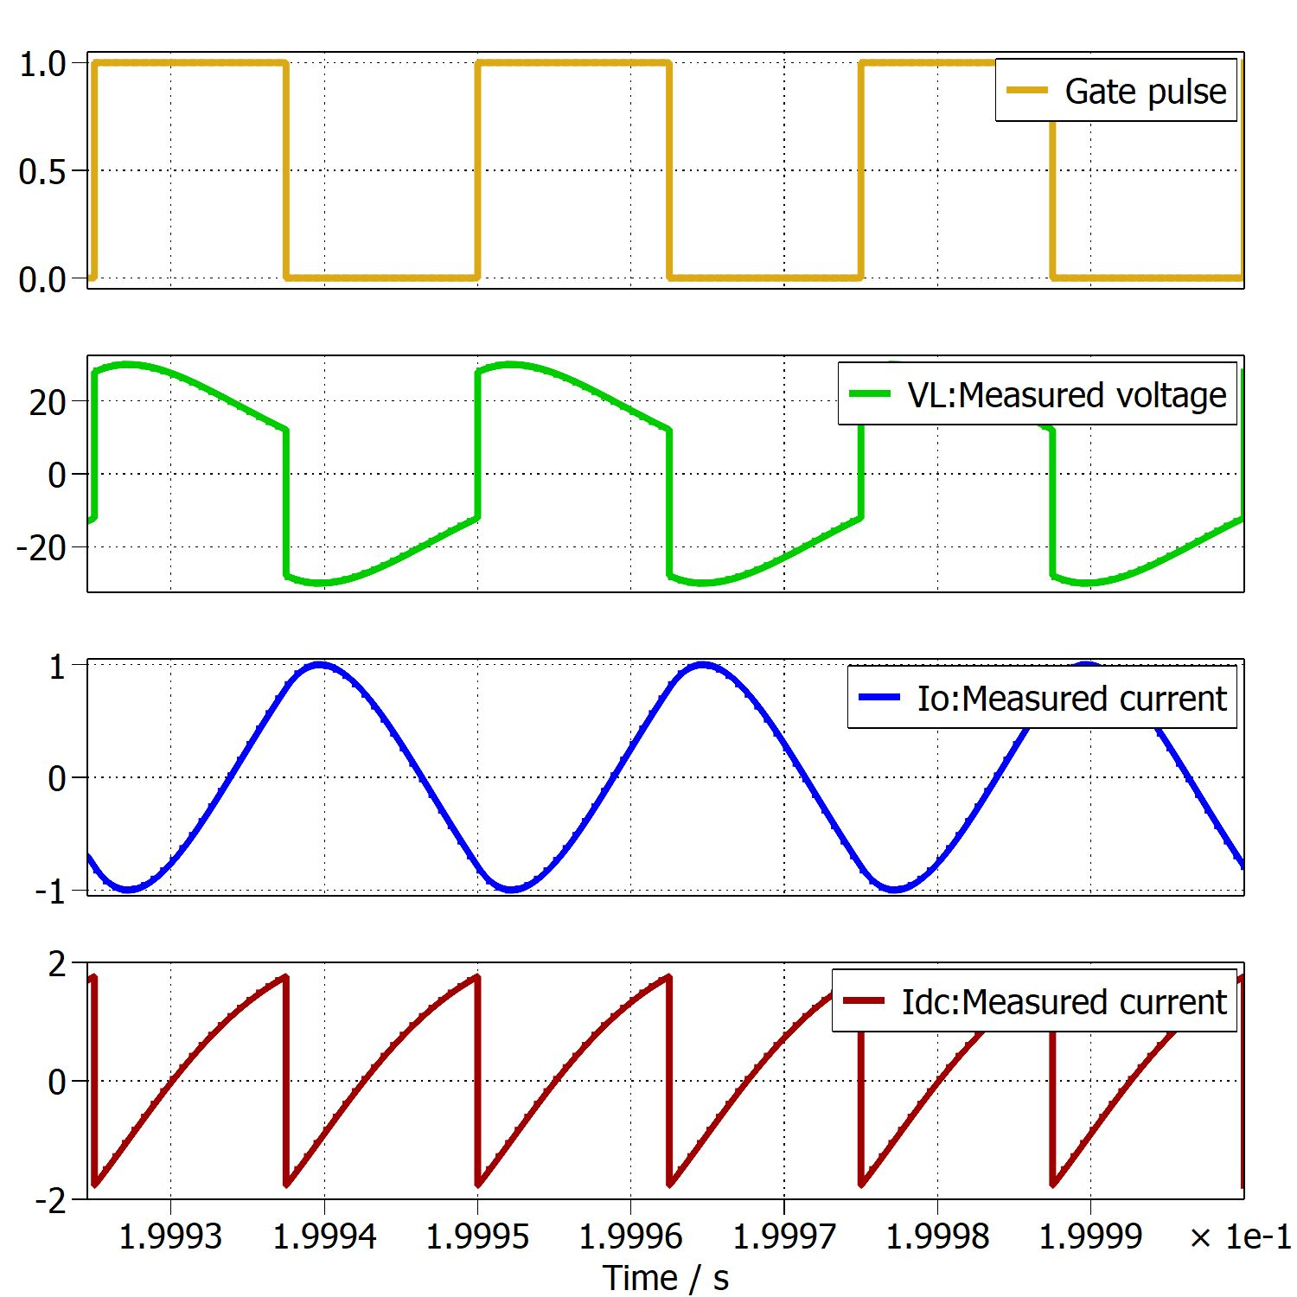
Parallel Resonant Inverter (cont.)
Gate, VL, Io, Idc
fsw = 10 kHz
fsw = 25 kHz
fsw = 40 kHz

Slide 17
Parameter values

Slide 18
Key Takeaways and Conclusion
Drawback with PRC – Large circulating currents flows at light load resulting in more conduction and switching losses
Future Work
Moving to LLC resonant converter in next stage to overcome these drawbacks.
LLC – Design and Control

Slide 19
Thank You

